Slide 1



MINOR PROJECT 1
Title: Complaint Management System FOR HOSTELS
Presented by: Ram Rawat
Raghav Singh Chauhan
Atul Belwal
Harshvardhan Singh
Guided by: Deepa Joshi Mam

Slide 2

Content
Introduction
Problem in hostels
Motivation
Objective
Flow Chart
Working
References

Slide 3

1. Introduction
Hostel complaint management is a system that allows student to register their dissatisfaction with the Hostel. It allows hostel to obtain feedback on how to improve their services and to decrease the likelihood of problems with the student base.
Complaint management is the process of handling, managing, responding to, and reporting customer grievances. This process requires a streamlined approach and constant monitoring to ensure faster resolutions.

Slide 4

2. Problem in Society
Wi-Fi Problem
Food Quality issue
Unhygienic mess
Poor Laundry Services
Roommate issue
There is not proper environment for study
Poor Housekeeping
Water Issues
Poor time management for vehicle
Ragging by seniors

Slide 5

3. Motivation
Due to these below points we get the motivation to build this project ---
1. It should be easily accessible.
2. Student can easily register their problem
3. A secure, tested environment that meets the most rigorous standards.
4.A standardized, consistent, auditable system for handling complaints and complaint data.
5.Consistent data capture at the point of intake.
6.Continuous complaint handling improvement based on performance monitoring.
7.The flexibility to adjust processes and customize the system based on your organization's needs.

Slide 6

4. Objectives
The main objective of implementing the online Hostel management system, to remove the challenges while dealing with the students and their issues.
An online complaint system is a useful solution for sorting out the issues in a systematic manner.
It saves time in clearing up issues efficiently to the logged complaints, into a web based customer complaint management system.
This is also strengthening the student loyalty by effective handling of the students complaints by the support team.
student complaint management software helps to attain a sustainable client database by offering the best customer support services.

Slide 7
6. Working
In this desktop application, for taking the students details firstly student need to register in that portal to generate his/her id password and then he/she needs to login for registering their issues. After that a pop-up window will gets appear and student will be need to add their details in the columns that are mentioned below:
Register Complaint
Status Update
Check Status
Report
About Us
Now, when the student registers their complain in the portal. Then, the admin needs to reply about their concern. So, there is different id- password for the admin portal. So, after login admin can easily update the feedback.

Slide 8
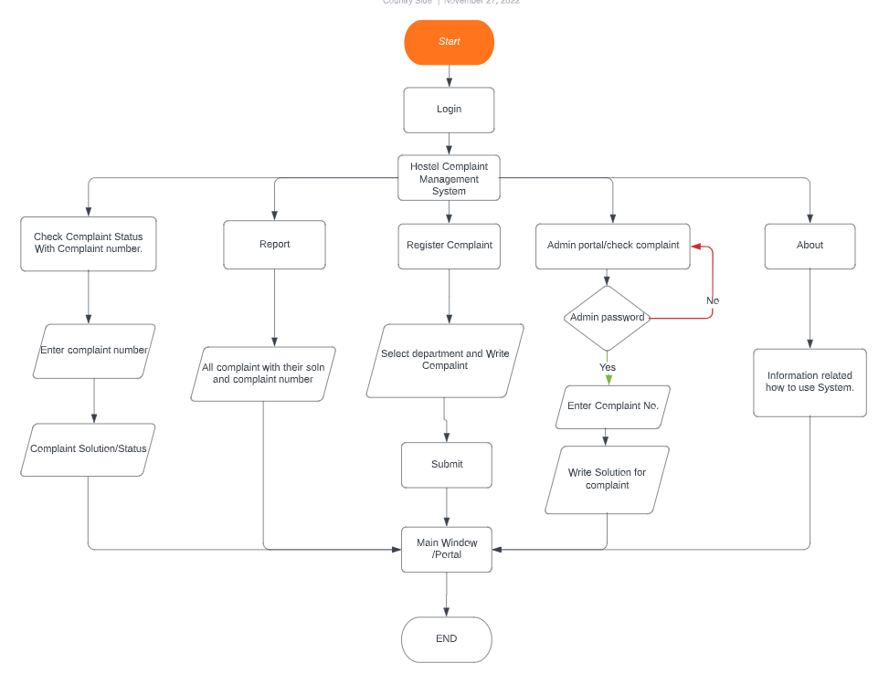
5. Flow Chart

Slide 9
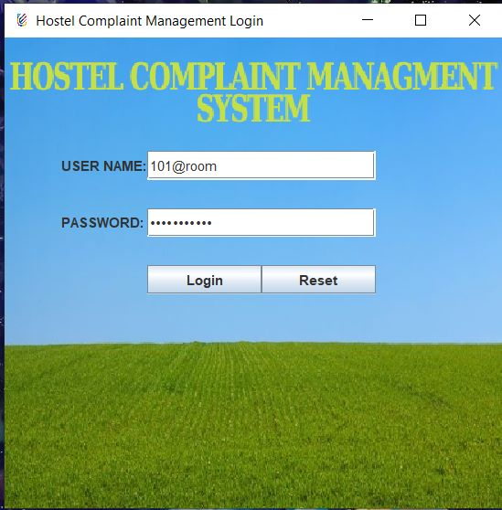
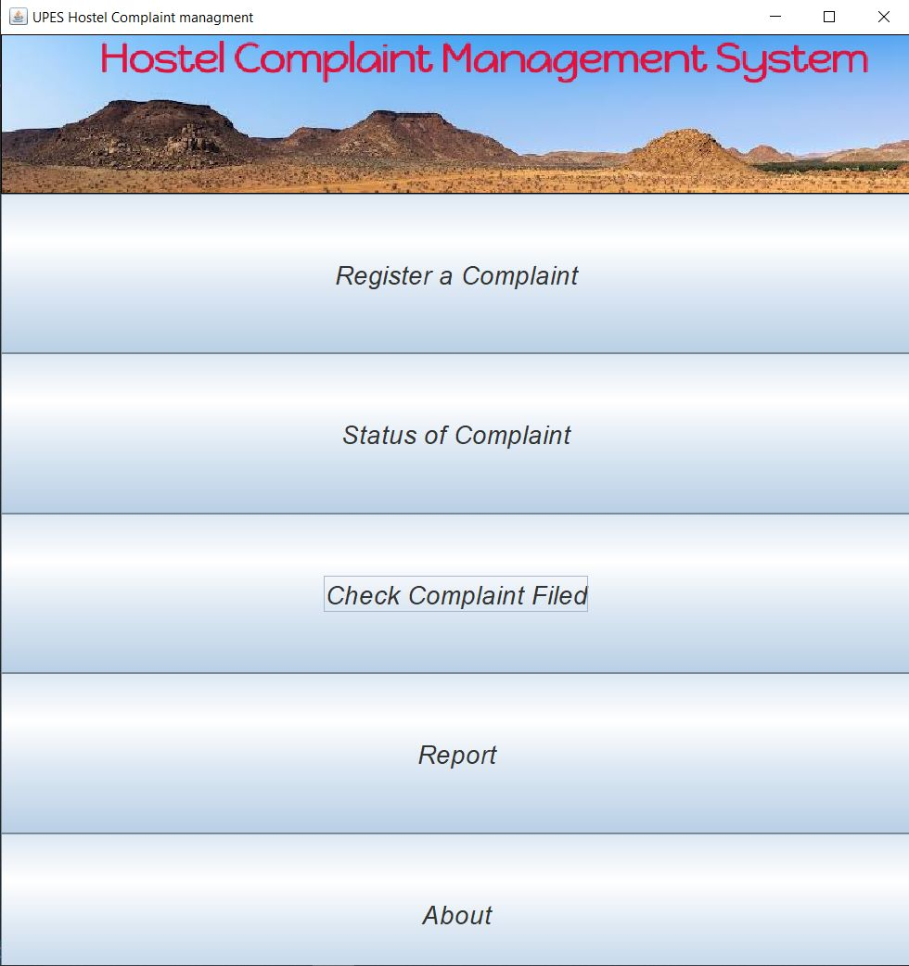
7. Code Snip

Slide 10
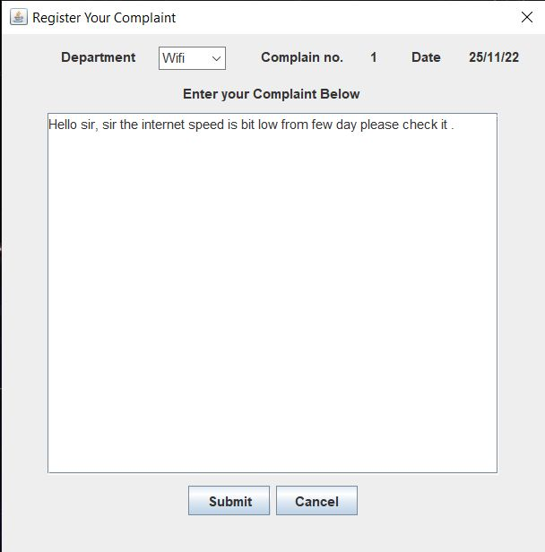
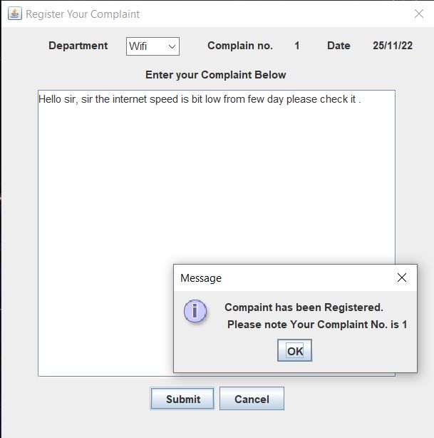

Slide 11
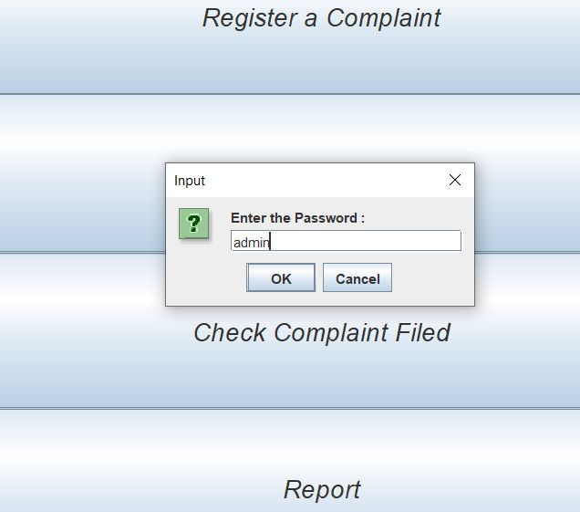
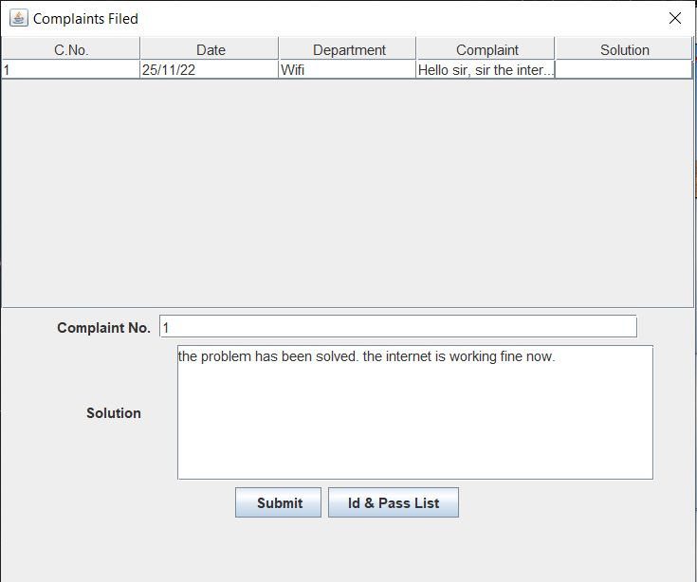

Slide 12
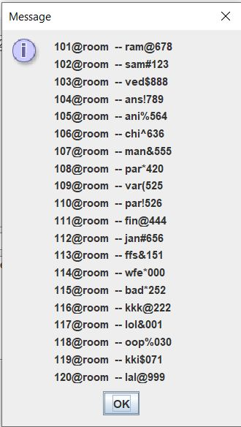
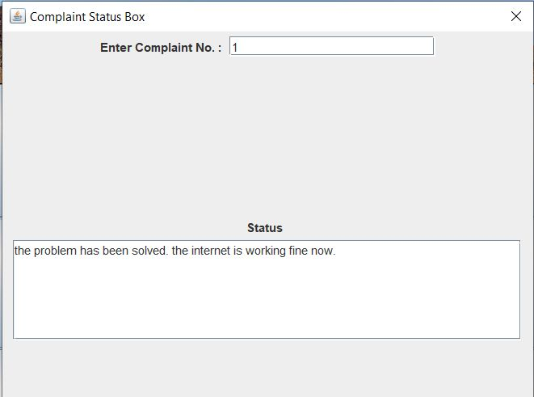

Slide 13
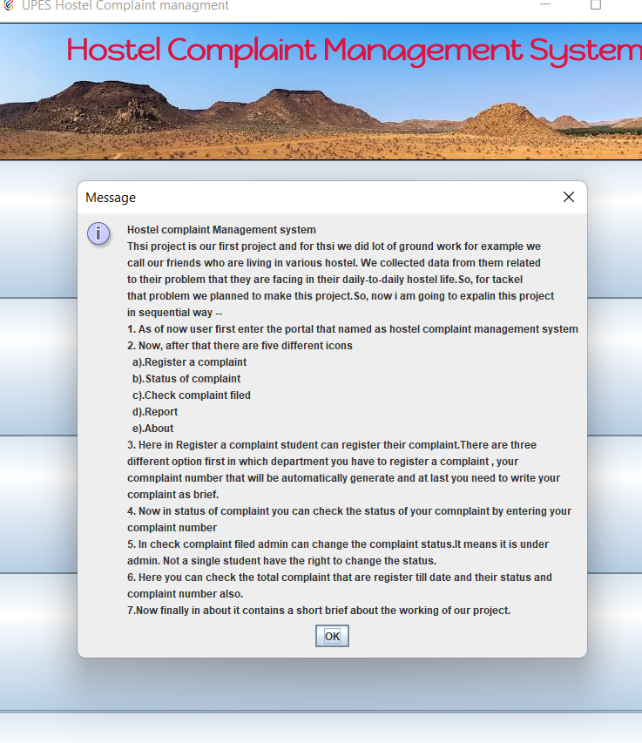
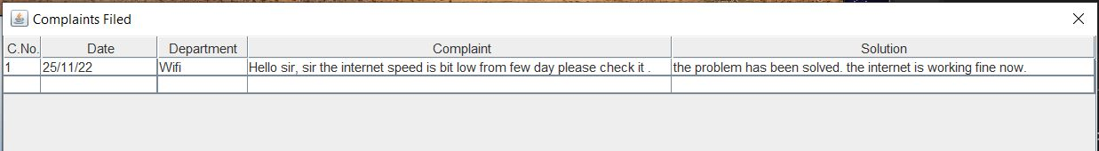

Slide 14
7. References
https://ieeexplore.ieee.org/abstract/document/8523949?casa_token=DKbMMe8s3JYAAAAA:MB5NNKG4R9AqBPkUBFMk2d-SeJ-9KWJFnuoNDsOF-Gh9XCKM9fGljCm0fOyqmCmsxqmrppYCtA4nNg
https://ieeexplore.ieee.org/abstract/document/5530119?casa_token=HznWVMA7XWMAAAAA:10SiH69kRfi_ej6xGSyhiHO9RP5QpQsZECGPsWIywhgMoP-PRIhYR686vB1ICq12qhKder1BmRNrUA
https://ieeexplore.ieee.org/abstract/document/5713449?casa_token=oGH6T-h5NWoAAAAA:JP3S2-H3YopuxqdEGo-f4tstrBkInriXisIWXJLPWQ03X1lzcr6BCwC43wrlFjLxC5xg1aw1veHL5A

Slide 15
Thank You

